Slide 1

Projektpräsentation SE: Arschloch
Gruppe 5: Ralph Segi, Jan Kaiser

Slide 2
Gliederung
Organisation: (Thema 2 u. 3)
Scrum
Git
TUI Development (Thema 4)
MVC
Model/Controller Code Coverage
Design Patterns
Components & Interfaces
Dependency Injection

Slide 3
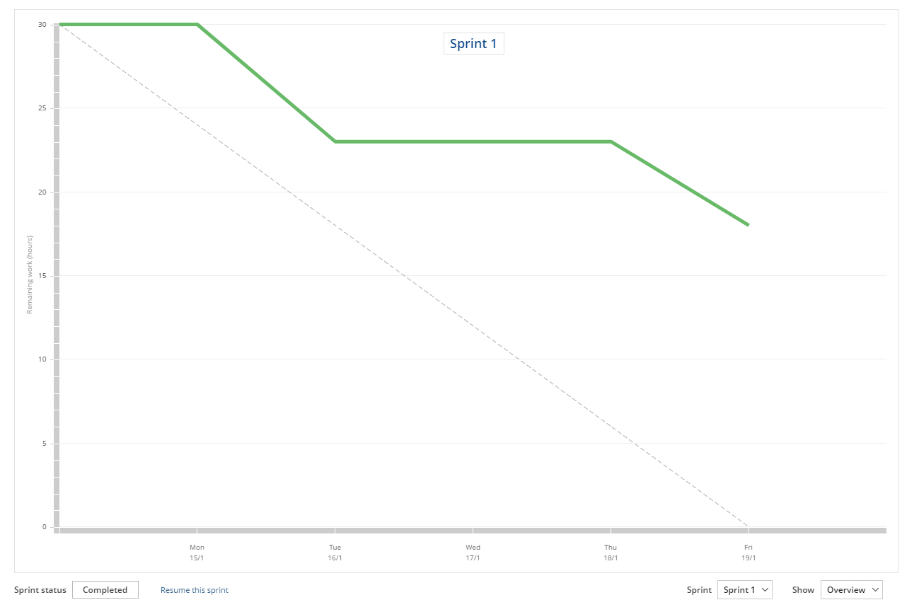
Scrum – Sprint 1

Slide 4
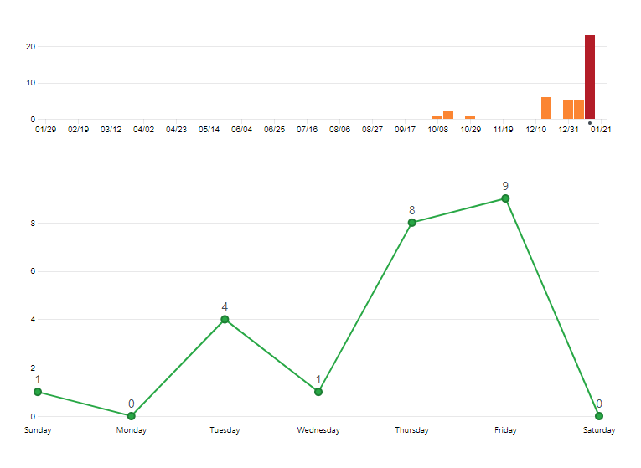
Git – Commits (Sprint 1)

Slide 5
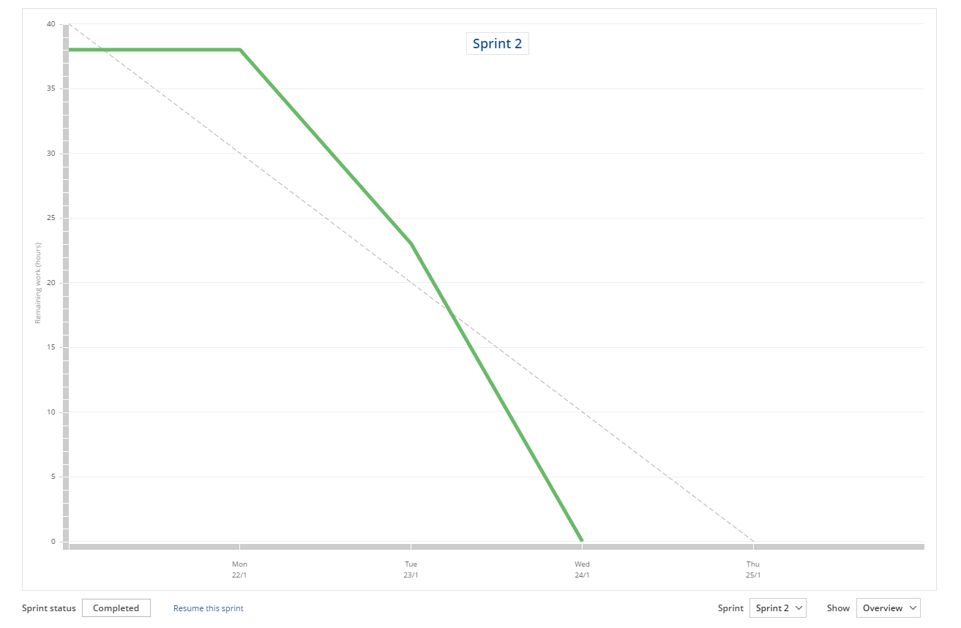
Scrum – Sprint 2

Slide 6
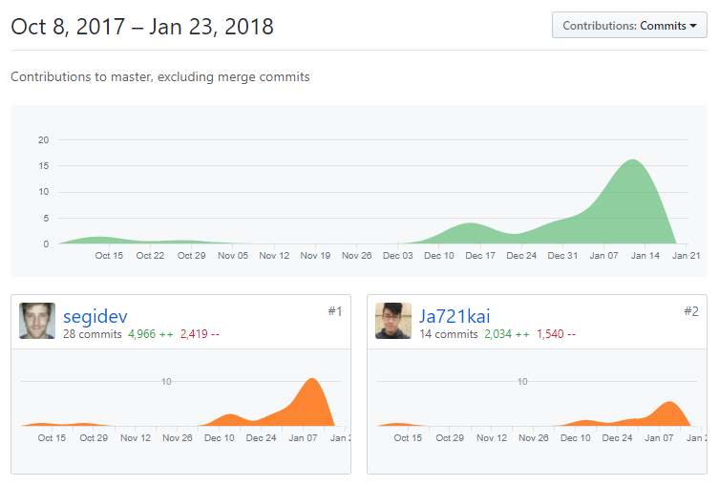
Git - Contributers

Slide 7
TUI Development
Logger?

Slide 8
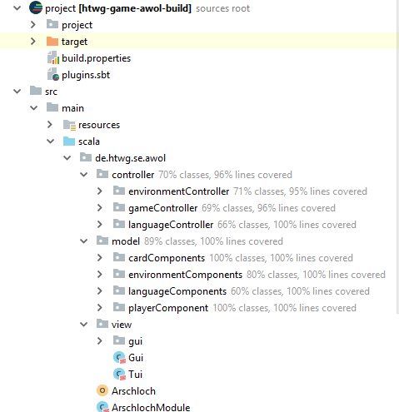
Model-View-Controller Architektur
environmentController:
Game Settings & JSON / XML
gameController:
controls game states
publishes events
languageController:
controls translations Ger/Eng
Model contains languages, card structure, deck structure, languages, messages, gui images, player class
View contains GUI / TUI

Slide 9
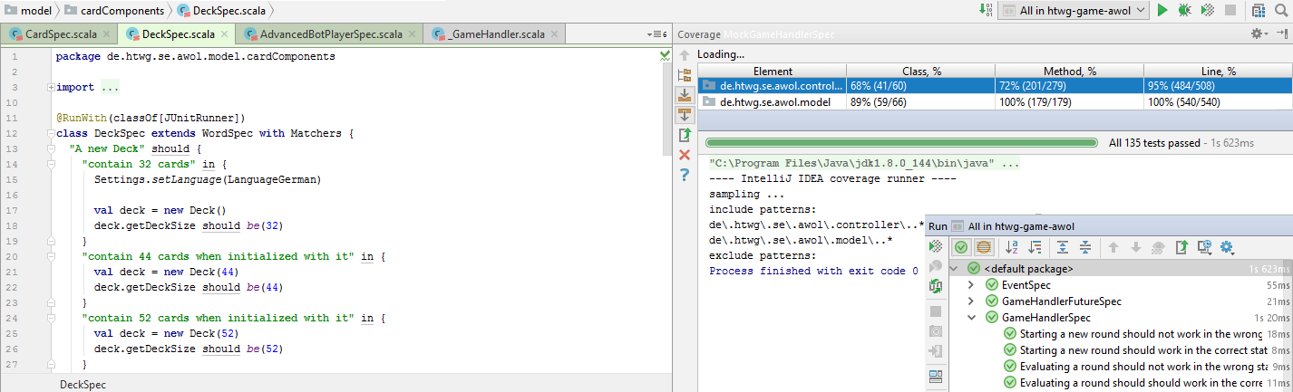
Code Coverage / Tests

Slide 10
Design Patterns
Observer
Singleton
Strategy

Slide 11
Observer Pattern
<Code Example / Code Structure picture> / UML Diagramm

Slide 12
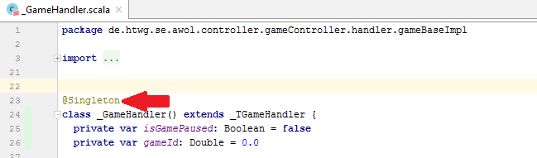
Singleton

Slide 13
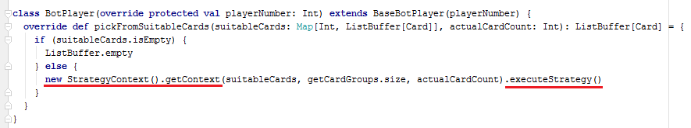
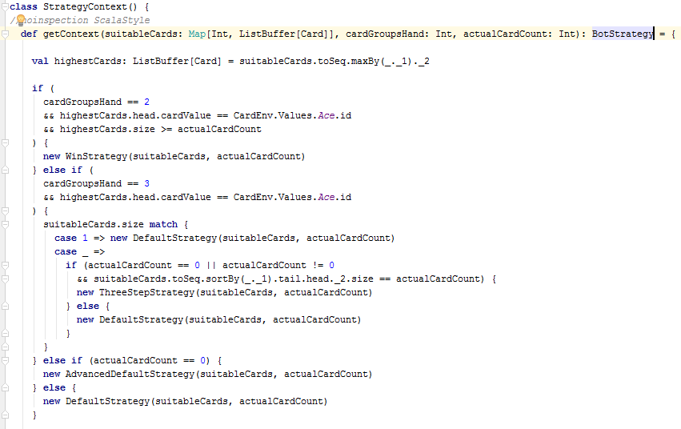
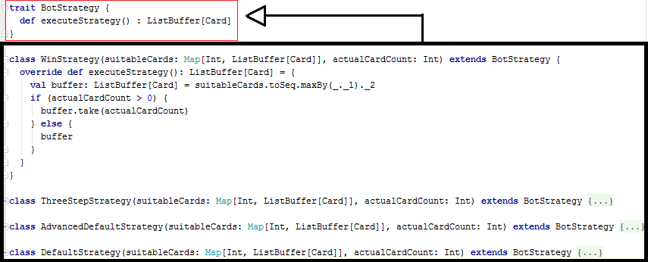
Strategy Pattern

Slide 14
GUI Development
<Code Example>
Scala Future?

Slide 15
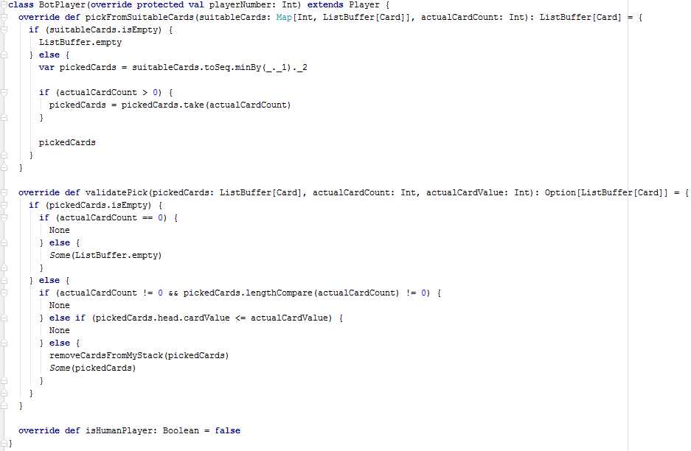
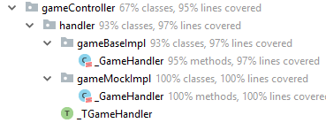
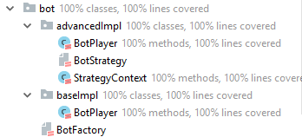
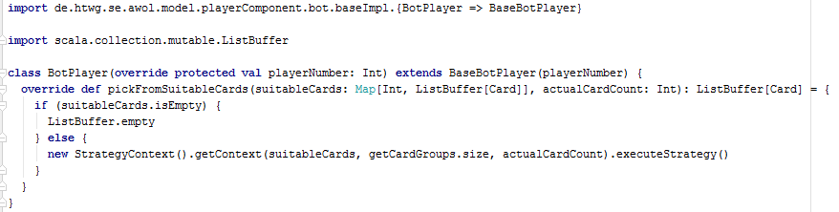
Components & Interfaces

Slide 16
Dependency Injection
<Code Example>

